Slide 1
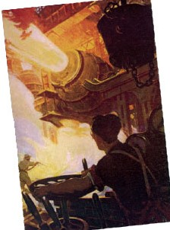

Slide 2
The Steelmaking Process
By the 1880s, steel had replaced steam as the great symbol of the Industrial Revolution. In huge steel mills, visitors watched with awe as tons of molten metal were poured into giant mixers. Read the excerpt below. As you read, underline important information to answer the questions. Answers must be in complete sentences using evidence from the passage to support your claims.
 | “At night the scene is indescribably wild and beautiful. The flashing fireworks, the terrific gusts of heat, the gaping, glowing mouth of the giant chest, the quivering light from the liquid iron, the roar of a near-by converter…combine to produce an effect on the mind that no words can translate.” ---J. H. Bridge, The History of the Carnegie Steel Company
1. What is the main idea of the quote?
2. How does the painting reinforce this idea?
3. Based on your knowledge of factory conditions during the Industrial Revolution, how do you think factory workers could view the steelmaking process?

Slide 3
Which of the following statements do you agree with the most?
Student Poll
Technology is always beneficial, as it makes life easier.
Technology can be beneficial, provided it doesn't control our life.
Technology can be destructive, as it breaks down traditions.
Technology is always destructive, as it makes life too hectic.
Throughout this chapter we will learn about how technology affected the daily lives of people

Slide 4
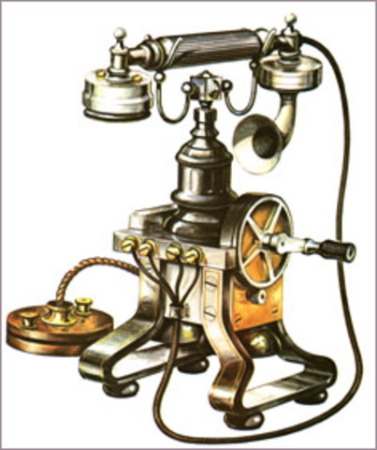
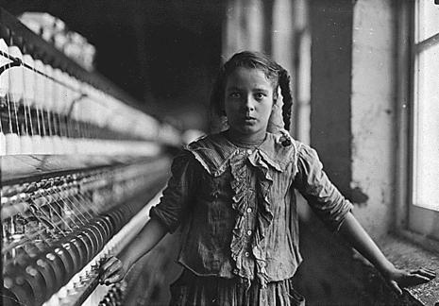
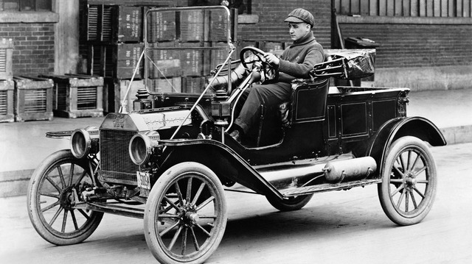
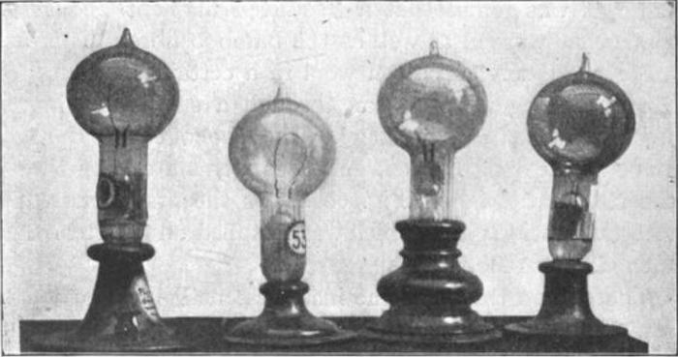
Chapter 9 Life in the Industrial Age (1800 – 1914)
Section 1 – The Industrial Revolution Spreads: New Technology & Business
Objectives:
List the industrial powers that emerged in the 1800s
Describe the impact of new technology on industry, transportation, and communication.
Understand how big business emerged in the late 1800s.
How did science, technology, and big business promote industrial growth?

Slide 5
Terms and People
Henry Bessemer – a British engineer who developed a new process for making steel from iron in 1856
Alfred Nobel – a Swedish chemist who invented dynamite in 1866
Michael Faraday – an English chemist who created the first electric motor in the 1800s
dynamo – a machine that is used to generate electricity
Thomas Edison – the American inventor who made the first electric light bulb in the 1870s
interchangeable parts – identical components that could be used in place of one another in manufacturing
assembly line – production method that breaks down a complex job into a series of smaller tasks
Orville and Wilbur Wright – American bicycle makers who designed and flew an airplane in 1903, ushering in the air age
stock – shares of a company
corporation – business owned by many investors who buy shares of stock and risk only the amount of their investment
cartel – a group of companies that join together to control the production and price of a product

Slide 6
During the early Industrial Revolution, inventions such as the steam engine were generally the work of gifted tinkerers. They experimented with simple machines to make them better.
By the 1880’s the pace of change quickened as companies hired professional chemists and engineers to create new products and machinery. The union of science, technology, and industry spurred economic growth.

Slide 7
Great Britain had been the first nation to industrialize. It tried to protect this head start by making rules against exporting inventions.
Nevertheless, a British mechanic opened factories in Belgium in 1807, making that country the second to industrialize.
By the mid 1800s, other nations in Europe—as well as the United States—joined Britain in the race to industrialize.

Slide 8
Germany, France, and the United States caught up to Britain quickly.
They benefited from abundant supplies of natural resources.
Europe and the United States also borrowed British technology.
Following its unification in 1871, Germany became Europe’s leading industrial power. The United States also advanced rapidly after the Civil War.
The World industrialized unevenly
The nations of eastern and southern Europe industrialized slowly. They lacked natural resources, capital, or ideal political conditions.
However, Japan, Canada, Australia, and New Zealand all industrialized during the late 1800s and built thriving economies.
Notes:
8

Slide 9
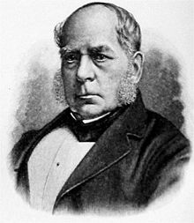
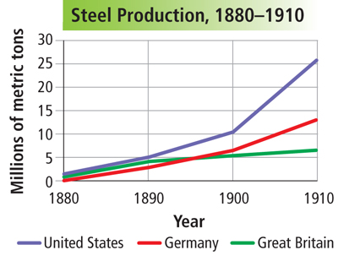
Steel Production and the Bessemer Process
American inventor William Kelly and British engineer Henry Bessemer independently developed a new process for making steel from iron.
In 1856 Bessemer patented the new process
Steel was lighter, harder, and more durable than iron, so it could be produced very cheaply.
As steel production soared, industrialized countries like Germany, France and the United States measured their success in steel output.

Slide 10
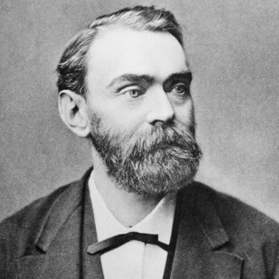
Innovations in Chemistry
Chemists created hundreds of new products, from medicines such as aspirin to perfumes and soaps.
Chemical fertilizers played a key role in increasing food production.
Swedish chemist Alfred Nobel invented dynamite in 1866
Much safer explosive than others used at the time
Widely used in construction and warfare
Dynamite earned Nobel a huge fortune
He willed his fortune to fund the famous Nobel prizes that are still awarded today

Slide 11
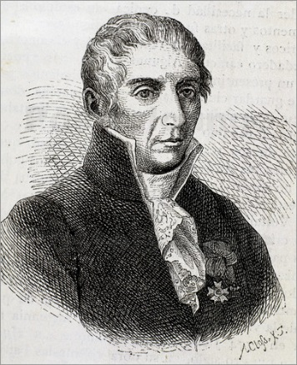
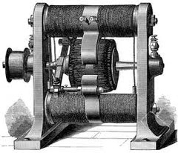
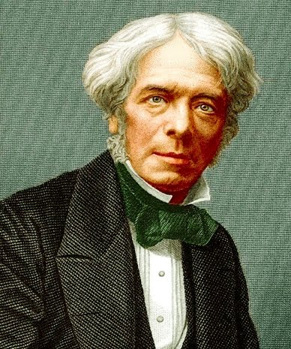
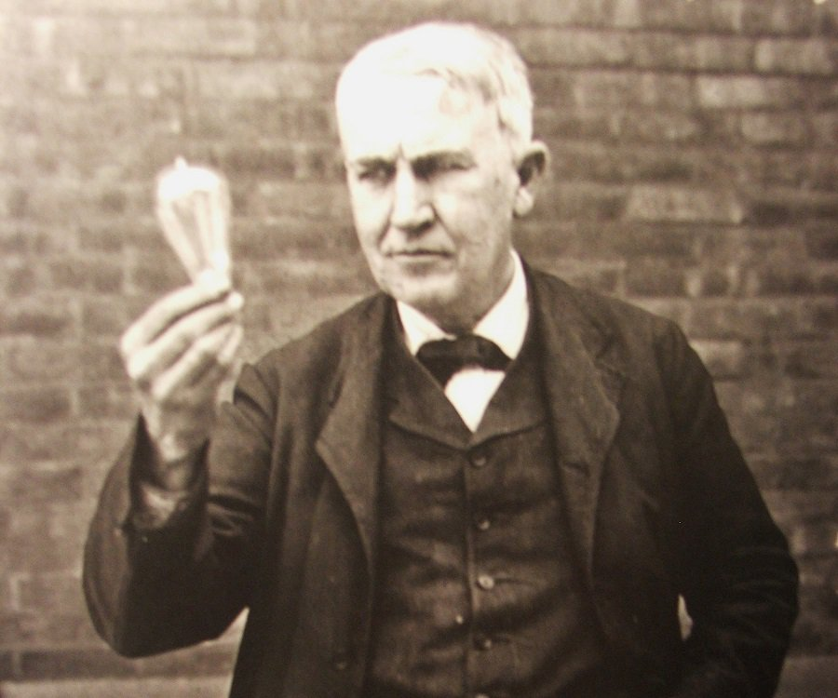
Electric Power Replaces Steam
In the late 1800s, a new power source---electricity---replaced steam as the dominate source of industrial power.
1800 Italian scientist Alessando Volta developed the first battery
English Chemist Michael Faraday created the first simple electric motor and the first dynamo, a machine that generates electricity.
Today, all electrical generators and transformers work on the principle of Faraday’s dynamo.
Dynamo
1870s American inventor Thomas Edison makes the first electric light bulb.
Soon, Edison’s “incandescent lamps” illuminated whole cities

Slide 12
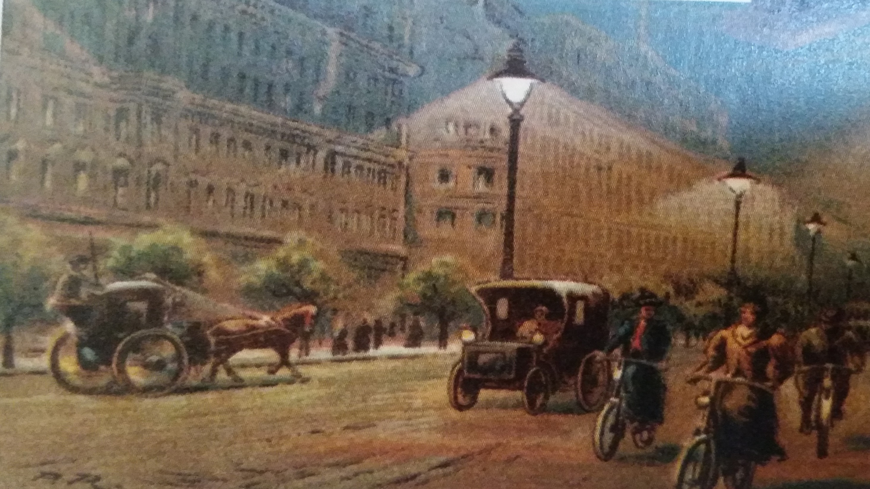
1. What do you notice in this painting?
2. Why was electricity important to industrialization?

Slide 13
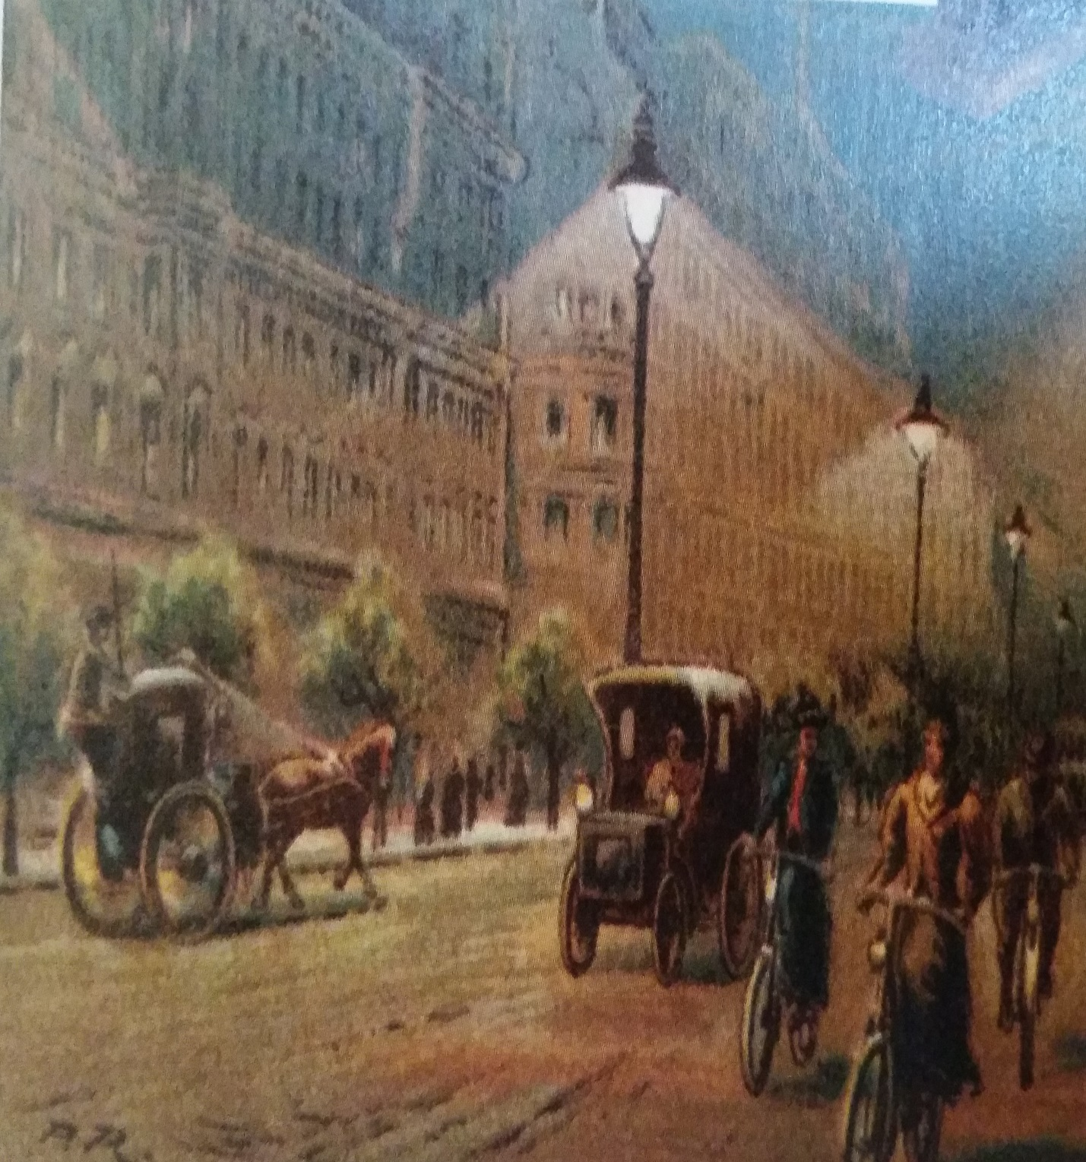
Electricity transformed the pace of growth during the Industrial Revolution because cities could be lit up at night and factories could run after dark.
It was the power source for the machines and assembly lines that mass-produced goods, making more products faster and more cheaply than ever before.
By the 1890’s cables carried electrical power from dynamos to factories.

Slide 14
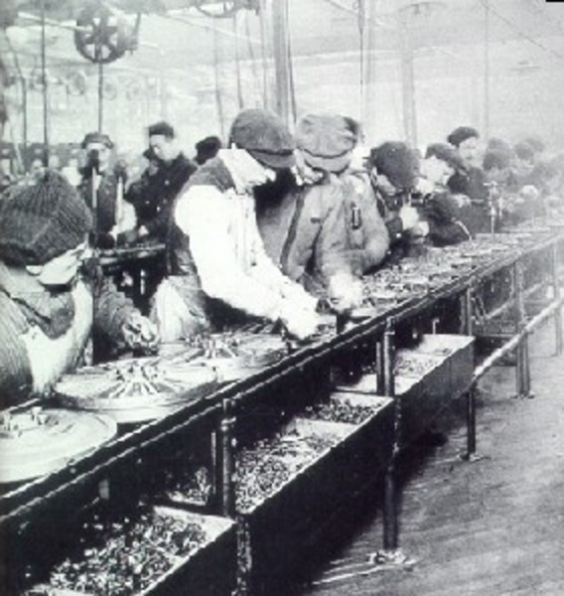
New Methods of Production
Factories still used large numbers of workers and power-driven machines to mass-produce goods.
To improve efficiency, manufactures designed products with interchangeable parts – identical components that could be used in place of one another.
Interchangeable parts simplified both the assembly and repair of products.
The basic features of the factory system remained the same during the 1800s.
By the early 1900s, manufactures introduced the assembly line.
Workers on an assembly line add parts to a product that moves along a belt from one work station to the next.
A different person performs each task along the assembly line.
This division of labor in an assembly line, like interchangeable parts, made production faster and cheaper, lowering the price of goods.

Slide 15
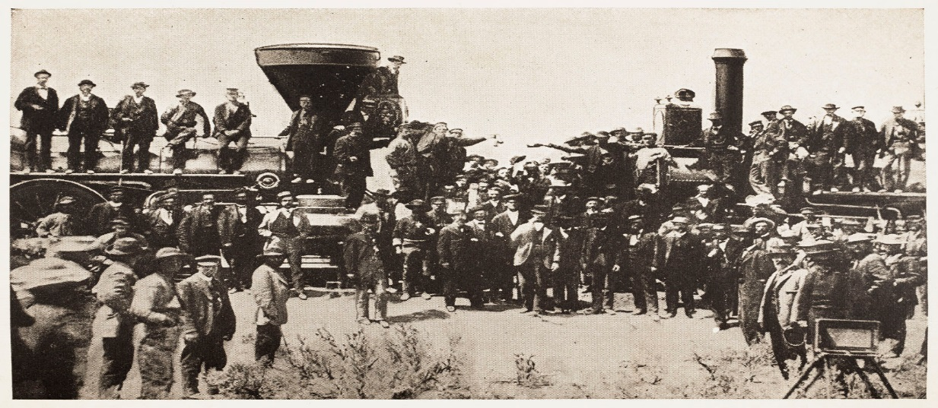
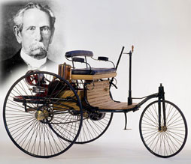
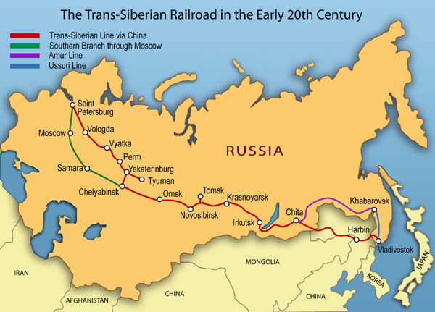
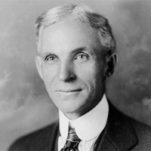
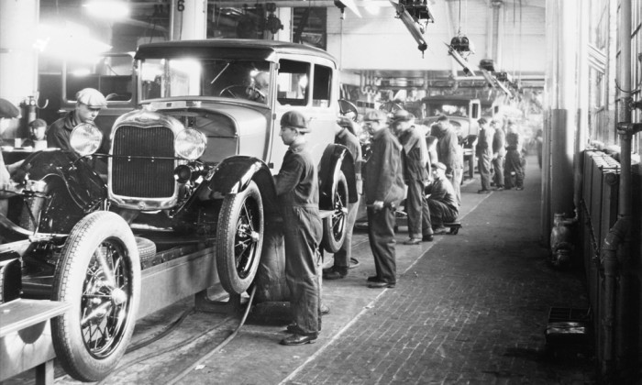
The transportation revolution that began with the first railroads continued.
Transcontinental railroads linked cities together.
Automakers such as Nikolaus Otto, Karl Benz, and Gottlieb Daimler changed the way people traveled by using gasoline to power internal combustion engines.
Henry Ford used the assembly line to mass-produce cars and make them affordable.

Slide 16
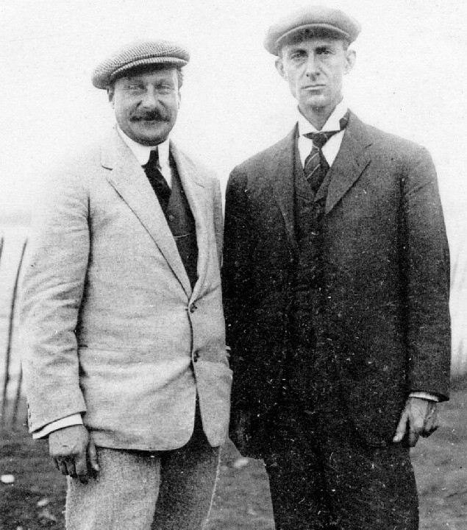
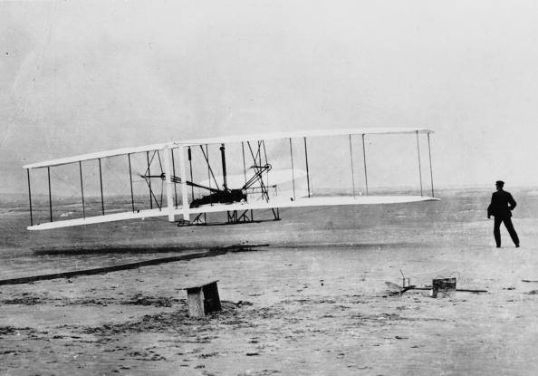
The internal combustion engine also made sustained flight possible.
Orville and Wilbur Wright flew the first airplane at Kitty Hawk, North Carolina, in 1903.
Commercial passenger travel would not begin until the 1920s.

Slide 17
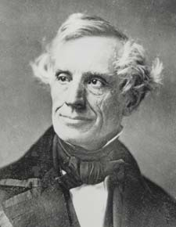
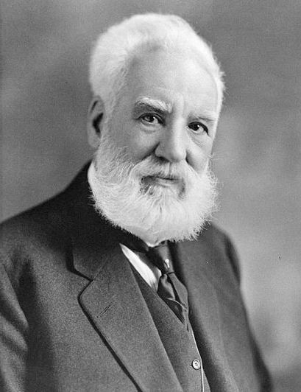
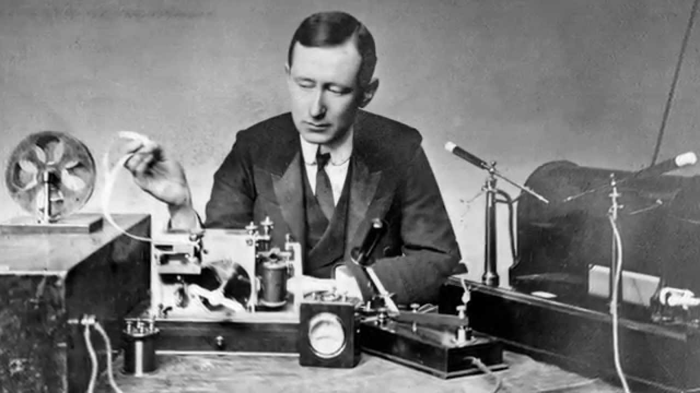
The revolution in communication made the world seem smaller.
Inventor | Major invention | Year
Samuel Morse American Inventor | Telegraph – could send coded messages over wires by means of electricity. | 1844
Alexander Graham Bell Scottish-born American Inventor | Telephone | 1876
Guglielmo Marconi | Radio – 1901 received a radio message, using Morse code. | Late 1890s
“Shortly before mid-day I placed the single earphone to my ear and starting listening…I heard, faintly but distinctly, pip-pip-pip…I know I felt for the first time absolutely certain that the day would come when mankind would be able to send messages without wires not only across the Atlantic but between the farthermost ends of the earth.”
Radio would become a cornerstone of today’s global communications network.

Slide 18
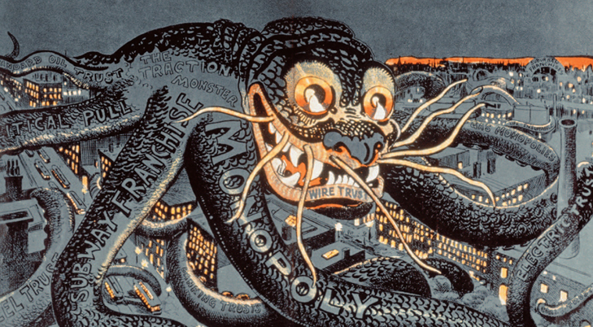
Big business began to dominate industry in the late 1800s.
Company owners sold stock to investors to get the capital needed to invest in new technology.
Companies became corporations, businesses owned by many stockholders.
Some business leaders created monopolies and cartels to control entire industries.
The rise of monopolies sparked a fierce debate.
Supporters said that monopolies made business more efficient and added to prosperity.
Reformers said that monopolies unfairly interfered with free competition. They sought laws to break up monopolies and regulate corporations.

Slide 19
The effects of industrialization were both positive and negative.
People worked very long hours in dangerous factories.
But new goods became widely available at low prices.
Patterns of world trade changed.
Western powers grew to dominate the world.

Slide 20
How did science, technology, and big business promote industrial growth?
The Industrial Revolution entered a second phase by the mid-1800s. Factory conditions slowly began to improve through the work of labor unions.
New industrial powers and products emerged that created more jobs. Giant companies arose due to changes in business organization. This second phase transformed Western economies.

